Slide 1

Preventing DNS Information Leakage through Automated DNS Misconfiguration Detection
J Sravani - 192372141
P Reddy Renuka - 192311062
ITA1408-Ethical Hacking
Course Faculty : Dr. S Parthiban,
Professor, SIMATS Engineering, SIMATS

Slide 2
Agenda
Abstract
Introduction
Problem Statement
Objectives
Architecture
Literature Review
Implementation
Result & Analysis
Conclusion
References

Slide 3
Abstract
DNS information leakage occurs due to misconfigured DNS settings, exposing sensitive network information to attackers.
The proposed system automatically performs DNS enumeration to collect DNS records and identify exposed assets.
Misconfiguration analysis detects security issues such as open zone transfer, open recursion, missing DNSSEC, and incorrect DNS records.
Security recommendations are generated to help administrators fix vulnerabilities and strengthen DNS security.
The system improves cybersecurity by preventing DNS information leakage through automated detection, continuous monitoring, and timely remediation.
The proposed solution is efficient, scalable, and reduces manual effort, making it suitable for organizations of all sizes to maintain a secure and reliable DNS infrastructure.

Slide 4
Introduction
DNS (Domain Name System) translates domain names into IP addresses, enabling communication between users and websites.
Misconfigured DNS servers can expose sensitive information such as internal IP addresses, hostnames, and network details.
DNS information leakage provides attackers with valuable data for reconnaissance and planning cyberattacks.
Manual detection of DNS misconfigurations is time-consuming, error-prone, and inefficient for large-scale networks.
An automated DNS misconfiguration detection system improves security by identifying vulnerabilities quickly and preventing information leakage.
The (DNS) is a critical component of internet communication, but misconfigurations can expose sensitive inforation and create security vulnerabilities.

Slide 5
Problem Statement
DNS misconfigurations can expose sensitive network information, making systems vulnerable to cyberattacks and data leakage. An automated detection system is needed to identify and prevent these security issues.
Manual detection of DNS configuration errors is slow and may miss critical vulnerabilities. A real-time automated solution can improve DNS security and prevent information leakage.
Exposed DNS records and incorrect settings allow attackers to gather valuable network information. Automated DNS misconfiguration detection helps secure DNS infrastructure and protects sensitive data.
Security Risks
Existing Limitations

Slide 6
Literature Review
S.NO | DETAILS OF THE JOURNAL | ALGORITHM | ADVANTAGES | DIS ADVANTAGES
1 | Almohri et al. (2021). DNS Security and Privacy: Challenges and Solutions. | DNS Security Analysis | Detects common DNS vulnerabilities such as open to configurations. | Limited automation and requires manual verification of detected issues.
2 | Kumar et al. (2023). Automated DNS Vulnerability Assessment Using Machine Learning. | Machine Learning-Based Detection | Automatically detects abnormal DNS configurations with improved accuracy. | Requires a large dataset for training and periodic model updates.
3 | Zhang et al. (2024). Intelligent DNS Misconfiguration Detection for Enterprise Networks. | Hybrid AI + Rule-Based Detection | Combines AI with security rules to accurately detect misconfigurations. | Higher computational cost and implementation complexity.

Slide 7
Objectives
Automated DNS Misconfiguration Detection – Automatically identifies DNS errors such as open zone transfers, dangling records, and incorrect configurations.
DNS Information Leakage Prevention – Detects and prevents the exposure of sensitive DNS information, including internal IP addresses and hostnames.
Improved Network Security – Reduces security risks by identifying DNS vulnerabilities before attackers can exploit them.
Real-Time Monitoring and Alerting – Continuously monitors DNS configurations and provides instant alerts for suspicious changes.
Risk Assessment and Reporting – Generates detailed reports with vulnerability analysis and remediation recommendations.
Reduced Manual Effort – Automates DNS security checks, minimizing human error and saving administrative time.

Slide 8
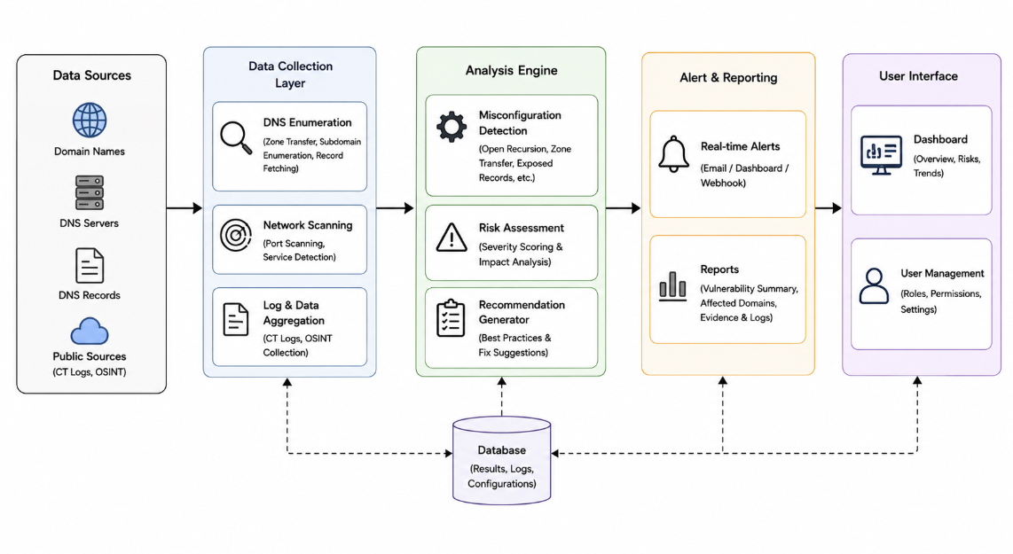
Architecture

Slide 9
Proposed Work
MODULE 1: DNS Enumeration
• DNS Record Enumeration Collects DNS records such as A, AAAA, MX, NS, TXT, CNAME, and SOA from the target domain.
• Subdomain Discovery Identifies subdomains, DNS servers, and publicly available DNS information.
MODULE 2: Misconfiguration Analysis
• DNS Misconfiguration Detection Detects configuration issues such as open zone transfer, open recursion, missing DNSSEC, and incorrect DNS records.
• Security Analysis Analyzes DNS settings to identify vulnerabilities and assess the risk of DNS information leakage.
MODULE 3: Security Recommendations
• Risk Assessment Classifies detected DNS issues as Low, Medium, High, or Critical based on their severity.
• Remediation Recommendations Provides security best practices and corrective actions to fix DNS misconfigurations and improve DNS security.

Slide 10
Description About the Dataset
DNS Records Collection The dataset contains DNS records such as A, AAAA, MX, NS, CNAME, TXT, and SOA collected from target domains.
Configuration Details It includes information about DNS settings, subdomains, name servers, and DNSSEC configuration.
Misconfiguration Labels The dataset identifies issues such as open zone transfer, open recursion, missing DNSSEC, and incorrect DNS records.
Security Analysis The collected data is used to detect DNS information leakage, assess security risks, and generate recommendations for improving DNS security.

Slide 11
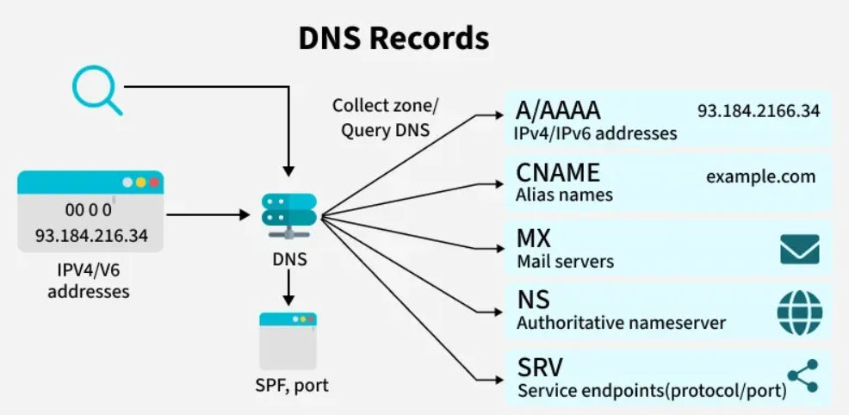
Module 1: DNS Enumeration
DNS Record Collection Retrieves DNS records such as A, AAAA, MX, NS, TXT, CNAME, and SOA.
Subdomain Discovery Identifies public subdomains associated with the target domain.
Name Server Identification Detects authoritative DNS servers responsible for the domain.
Zone Information Gathering Collects publicly available DNS configuration and zone details.
DNS Information Validation Verifies the accuracy and availability of DNS records before further security analysis.

Slide 12
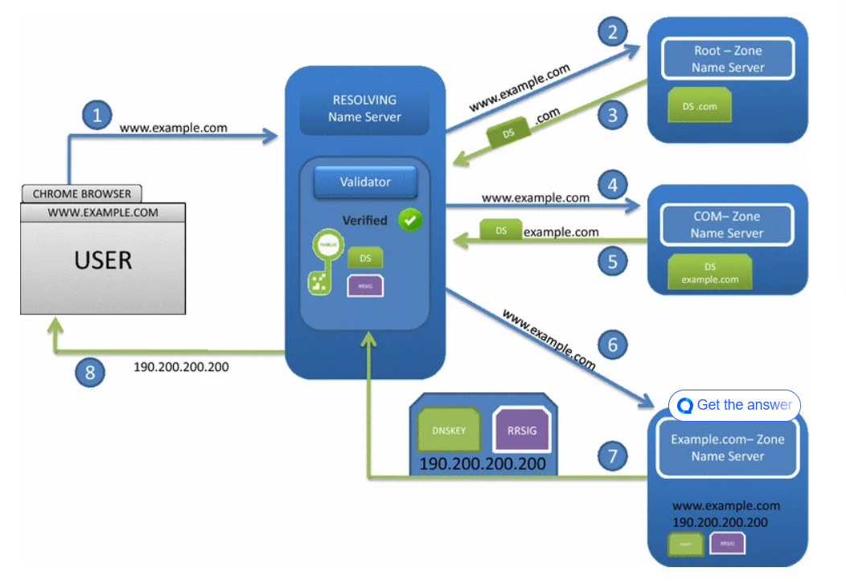
Module 2: Misconfiguration Analysis
Open Zone Transfer Detection Detects unauthorized DNS zone transfers (AXFR) that expose DNS records.
Open Recursive DNS Detection Identifies DNS servers that allow recursive queries from unauthorized users.
DNSSEC Validatio Checks whether DNS Security Extensions (DNSSEC) are correctly configured.
DNS Record Verification Detects missing, incorrect, duplicate, or outdated DNS records.
Security Risk Analysis Analyzes detected misconfigurations and evaluates the risk of DNS information leakage.

Slide 13
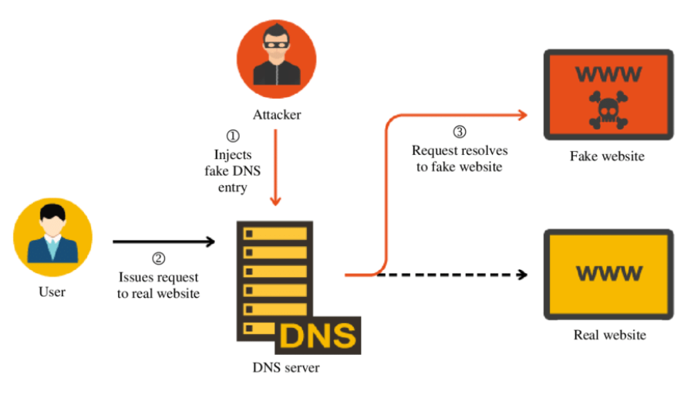
Module 3: Security Recommendations
Risk Assessment Classifies detected DNS issues as Low, Medium, High, or Critical based on severity.
Configuration Fixes Recommends corrections for DNS misconfigurations such as open recursion and zone transfer.
DNSSEC Implementation Suggests enabling and properly configuring DNSSEC to improve DNS security.
Access Control Recommendations Advises restricting unauthorized DNS queries and limiting zone transfer access.
Security Report Generation Generates a detailed report with detected issues, risk levels, and recommended mitigation steps.

Slide 14
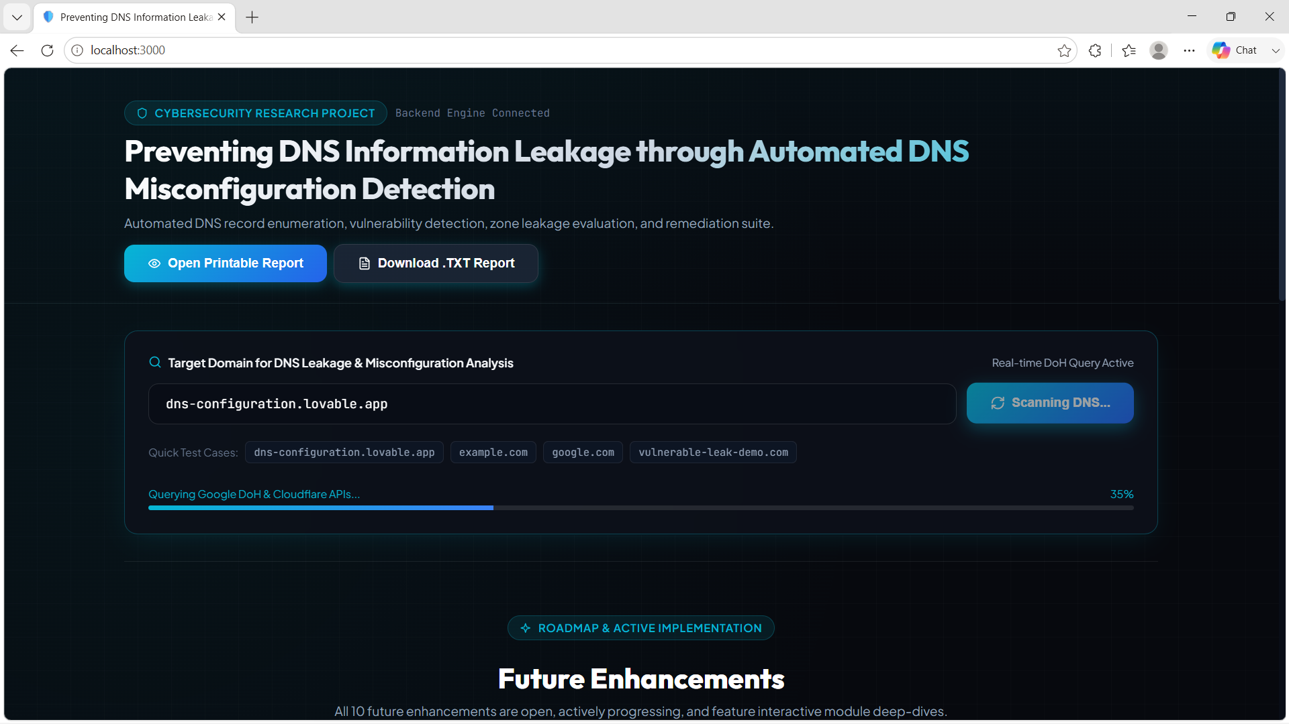

Slide 15
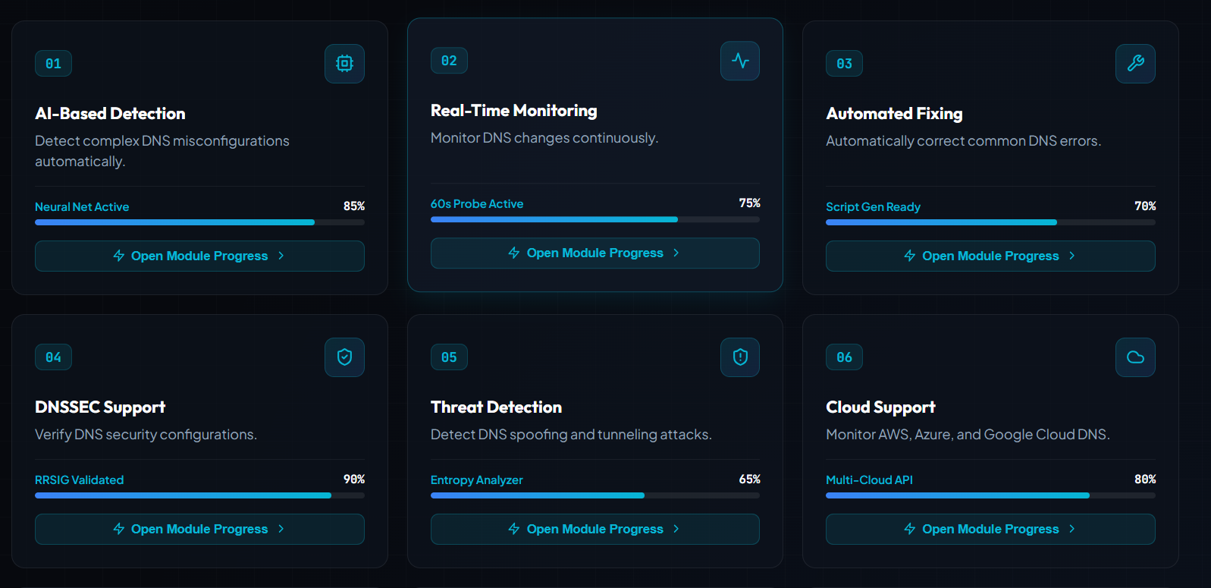

Slide 16
Conclusion
The Preventing DNS Information Leakage through Automated DNS Misconfiguration Detection system provides an effective solution for identifying and preventing DNS-related security risks.
By automatically enumerating DNS records, detecting misconfigurations such as open zone transfers, open recursion, and missing DNSSEC, and generating security recommendations, the system helps protect sensitive DNS information from unauthorized access.
It reduces manual effort, improves the accuracy of vulnerability detection, and enhances the overall security and reliability of DNS infrastructure.
Overall, this project offers a practical, efficient, and scalable approach to strengthening DNS security and preventing information leakage.

Slide 17
Future Enhancements
AI-Based Detection – Detect complex DNS misconfigurations automatically.
Real-Time Monitoring – Monitor DNS changes continuously.
Automated Fixing – Automatically correct common DNS errors.
DNSSEC Support – Verify DNS security configurations.
Threat Detection – Detect DNS spoofing and tunneling attacks.
Cloud Support – Monitor AWS, Azure, and Google Cloud DNS.
Instant Alerts – Notify administrators about critical issues.
Security Dashboard – Display vulnerabilities and risk levels.
SIEM Integration – Connect with security monitoring tools.
Scalable Scanning – Support large-scale domain monitoring.

Slide 18
References
Internet Engineering Task Force – RFC 1034: Domain Names – Concepts and Facilities. Defines the fundamental concepts and architecture of the Domain Name System (DNS).(2025)
Internet Engineering Task Force – RFC 1035: Domain Names – Implementation and Specification. Describes the implementation, DNS resource records, and communication protocols.(2024)
Internet Corporation for Assigned Names and Numbers – DNS Security Best Practices. Provides guidelines for secure DNS configuration and protection against information leakage.(2023)
OWASP Foundation – OWASP Top 10 Security Risks. Highlights common security vulnerabilities and recommended security practices.(2025)
National Institute of Standards and Technology – NIST Cybersecurity Framework (CSF). Offers standards and best practices to manage and reduce cybersecurity risks.(2024)
SANS Institute – DNS Security and Hardening Guidelines. Explains techniques for securing DNS infrastructure and preventing DNS-based attacks.(2025)

Slide 19

THANK YOU

